Slide 1

Data Analytics Bootcamp
Project 1 | Group 4
2021

Slide 2

World Happiness
Report
2015 - 2019

Slide 3
Meet the Team
Alysha Snowden
Alvin Lucero
Bec Goulding
Ernest Bondi
Notes:
Include the name of the Project and Group Members

Slide 4
Contents
Motivation & Summary
Questions & Data
Data Clean-up & Exploration
Data Analysis
Discussion
Post Mortem
Notes:
Recommended presentation structure
Update to align with powerpoint once completed

Slide 5
Introduction:
Notes:
Write overview of “happiness” and brief summary of the world happiness report
Detail Data sources used
Elaborate on the questions you asked, describing what kinds of data you needed to answer them, and where you found it
https://www.kaggle.com/mathurinache/world-happiness-report

Slide 6

Hypothesis:
Is happiness dependent on Economic (GDP per Capita)?
Questions:
Where are the ten Happiest Countries in the world?
Why are they the Happiest Countries?
Where does Australia rank in the world?
Notes:
Define the core message or hypothesis of your project.
Is happiness dependent on Economy (GDP per Capita)
Describe the questions you asked, and why you asked them.
What are the ten Happiest Countries in the world?
Why are they the Happiest Countries?
Where does Australia rank in the world?
Describe whether you were able to answer these questions to your satisfaction, and briefly summarize your findings.

Slide 7
Questions & Data
Notes:
Elaborate on the questions you asked, describing what kinds of data you needed to answer them, and where you found it

Slide 8
Data Clean-up & Exploration
Notes:
Describe the exploration and clean-up process
Discuss insights you had while exploring the data you didn’t anticipate
Discuss any problems that arose after exploring the data, and how you resolved them
Present the discuss interesting figures developed during exploration, ideally with the help of Jupyter Notebook

Slide 9
Data Analysis
Notes:
Discuss the steps you took to analyse the data and answer each question you asked in your proposal
Present and discuss interesting figures developed during analysis, ideally with the help of Jupyter Notebook

Slide 10
Happiness Variables
Health (Life Expectancy)
Generosity
Trust (Government Corruption)
Family
Freedom
Economy (GDP per Capita)
Notes:
Characteristics:
Trust (Government Corruption)
Generosity
Health (Life Expectancy)
Family
Freedom
Economy (GDP per Capita)

Slide 11
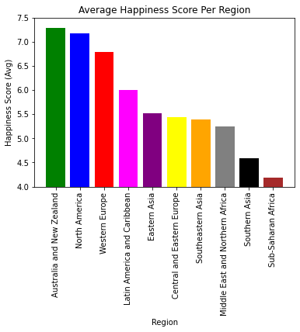
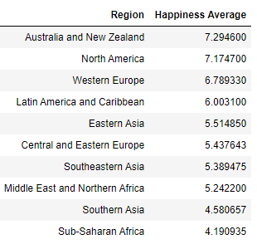
Bar Graph: Region

Slide 12
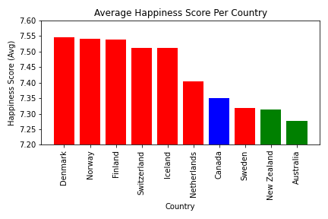
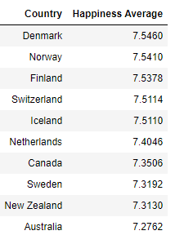
Bar Graph: Country

Slide 13
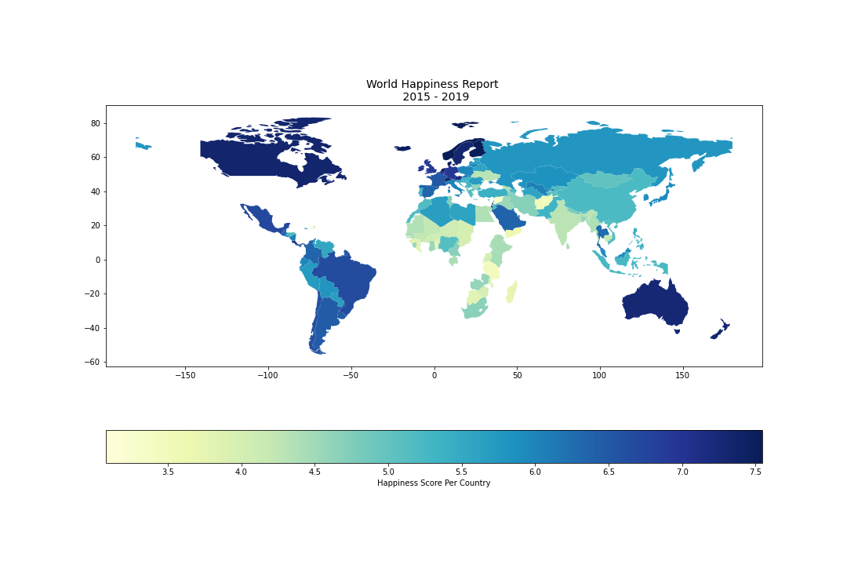
World Map:
Where are the ten happiest Countries in the world?
1. Denmark
2. Norway
3. Finland
4. Switzerland
5. Iceland
6. Netherlands
7. Canada
8. Sweden
9. New Zealand
10. Australia
Notes:
Geopandas Choropleth Map

Slide 14
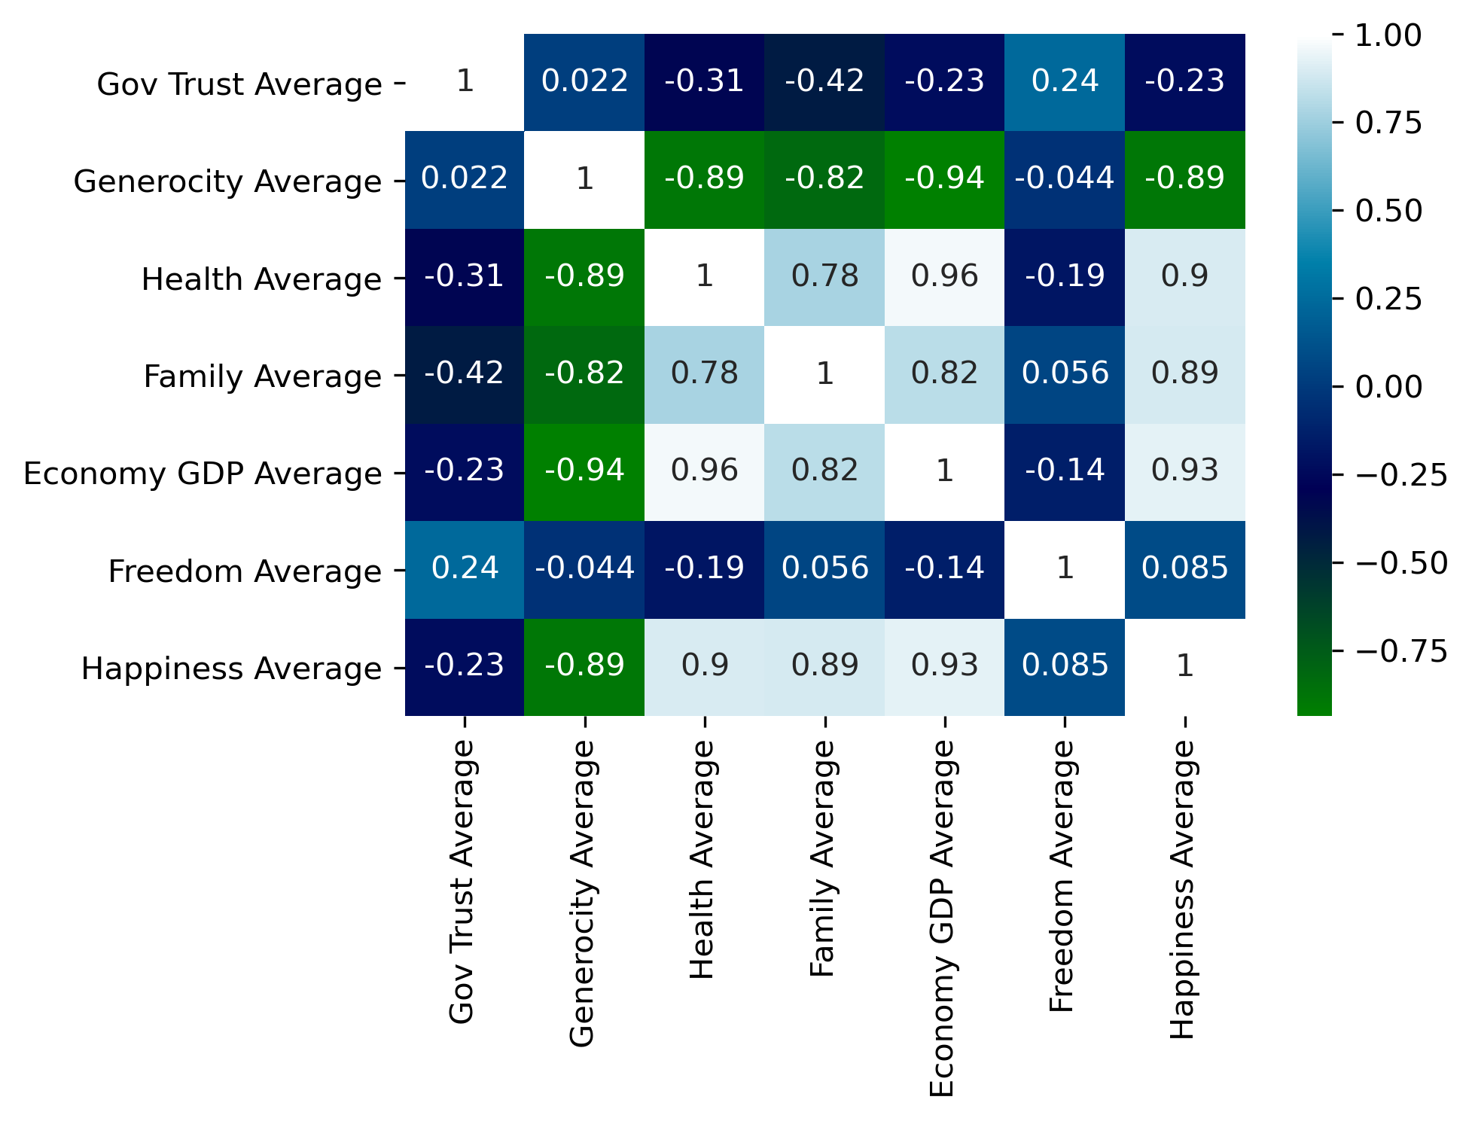
Correlation Matrix:
Economy GDP
Health
Family
Notes:
Seaborn Correlation Heatmap

Slide 15
Discussion
Notes:
Discuss your findings. Did you find what you expected to Find? If not, why not? What interferences or general conclusions can you draw from your analysis.

Slide 16
Post Mortem
Notes:
Discuss any difficulties that arose, and how you dealt with them.
Discuss any additional questions that came up, but which you didn’t have time to answer. What would you research next, if you had two more weeks

Slide 17

Notes:
Open floor Q&A with the audience

